Slide 1
StreamFlow Churn Intervention
October 25, 2025

Slide 2
The Crisis and The Solution
50% CHURN CRISIS: LAUNCH "7-HOUR KICKSTART"
1. Problem: 50% of new users churn immediately (wasting acquisition budget).
2. Root Cause: Failure to hit the critical Week 1 engagement threshold.
3. Action: We must launch the "7-Hour Kickstart" program to recover 30% of lost customers.

Slide 3
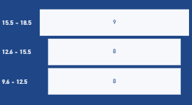
The Root Cause (The Threshold Proof)
The Single Failure Point: The 9.6-Hour Threshold
1. Causal Link: Retention begins only after a user crosses the 9.6 - 12.5 hour watch window in their first 7 days.
2. Our Target: We need to drive users past a simplified, achievable goal of 7 hours in Week 1. 3. Proof: All non-churn users fall into this category or higher.
Retention only starts in the 9.6 to 12.5 hour category.

Slide 4
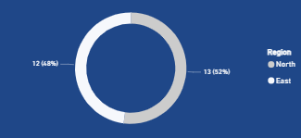
Where to Focus (The Isolation Proof)
Isolation Strategy: 100% Churn in North & East
1. Problem Area: 100% of customers acquired in the North and East regions churn.
2. Users in these regions watch barely 1 hour in Week 1.
3. Strategy: 100% of the "7-Hour Kickstart" program budget must be focused on these two markets.
The North and East regions are the source of the churn problem.

Slide 5
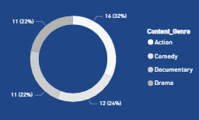
The Action Plan (The Solution & Next Steps)
Immediate Intervention: The "7-Hour Kickstart" Program
1. Nudge: Offer a Free Episode Nudge using the high-performing Action genre (32% preference).
2. Reinforcement: Implement daily, non-intrusive Gamified Reminders tracking progress to the 7-hour goal.
3. Long-Term: Budget must be allocated for UI upgrades and affordable subscription plans (Priority 2).
Action (32%) is the most effective content to drive initial viewing habit.

Slide 6

Conclusion and Call to Action
Recommendation: Approve "7-Hour Kickstart" Pilot
1. Immediate Goal: Launch the targeted pilot to recover 30% of lost customers.
2. Next Step: Begin development for the Gamified Reminders intervention.
3. Long-Term: Schedule follow-up discussion on UI Upgrade and Pricing Strategy.
Thank You / Questions?

